Slide 1

Music Recommendation System
Riya Sawant 20104078
Srusti Patil 20104066
Ritvik Shetty 20104067
Project Guide
Ms. Rujata Chaudhari
Notes:
1

Slide 2
Contents
Introduction
Objectives
Scope
Literature Survey
Proposed System
Project Outcomes
Block Diagram
Use Case/DFD
Technology Stack
Suggestions in Review-1
Result and Discussion
Conclusion and Future Scope
References
Notes:
2

Slide 3
1. Introduction
With the rise of digital content distribution, we have access to a huge music collection. With millions of songs to choose from, we sometimes feel overwhelmed. Thus, an efficient music recommender system is necessary in the interest of both music service providers and customers
Our music recommender system is large-scale and personalized. We learn from users listening history and features of songs and predict songs that user would like to listen to.
Notes:
3

Slide 4
Introduction :
Problem Identified :
In today's fast-paced world, people have access to an overwhelming amount of music from a variety of sources. With so much content available, it can be difficult for music lovers to discover new artists and songs that match their tastes.
Solution Proposed :
Our goal is to develop a music recommendation system that can provide highly personalized recommendations to users based on their listening history and preferences. This system should be able to analyze a user's past listening habits

Slide 5
2. Objectives
The objective of the Music Recommendation is
To enhance user experience by providing personalized music recommendations.
To discover new music by different categories.
To understand user’s music preferences
To provide user friendly experience without any cost.
Notes:
5

Slide 6
3. Scope
Can access songs by a particular album and artists.
Can also add their favourite songs.
Can create a playlist of their own.
Can listen to similar songs at one place.
Notes:
6

Slide 7
4. Literature Survey
Sr.no | Title | Author(s) | Year | Outcomes | Methodology | Result
1 | Content-based Recommender Systems | Pasquale Lops, Marco American state Gemmis, and Giovanni Semeraro | 2010 | The proposed system improved customer satisfaction and sales revenue by providing personalized recommendations and accurate sales forecasting. | Advantages: Learning of рrоfile is made easy. Quality improves overtime. Соnsiders implicit feedback. Disadvantages: Does not completely overcome the problem of over specialization and serendipity. | Through this , we have learned about content based recommendations
2 | Feature-based Opinion Mining Using Cosine Similarity | Mahesh Chandra and P. Radha Krishna | 2014 | It proposes a feature-based opinion mining system that uses cosine similarity to measure the similarity between the features of products and the opinions of users. | It includes data includes, preprocessing, sentiment analysis, feature opinion matrix, cosine similarity and ranking finally. | Through this we have implemented cosine similarity rule in our recommendation system.
Notes:
7

Slide 8
5. Proposed System
A music recommendation system which is better and easy to use.
The system will predict songs based on users behavior.
The system will take a song as an input and recommend no. of songs based on users request.
The goal of this recommendation system would be to provide personalized content by rightly identifying what the user wants and save their time.
To achieve this we will use machine learning techniques to make a recommendation model.
This model will be able to suggest songs based on users choices.
Notes:
8

Slide 9
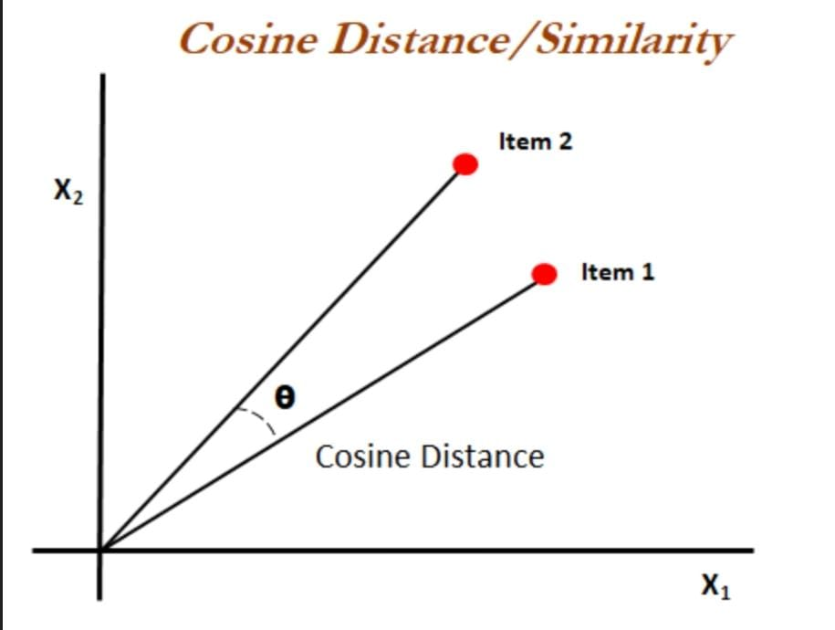
Algorithm Used :
Content Based Recommendation
Cosine Similarity Method

Slide 10
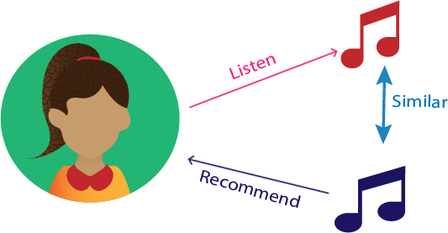
6. Outcome of Project
User Can create account and Log in
User can search songs of a particular language and artist
User can create it’s own playlist and like songs.
Notes:
10

Slide 11
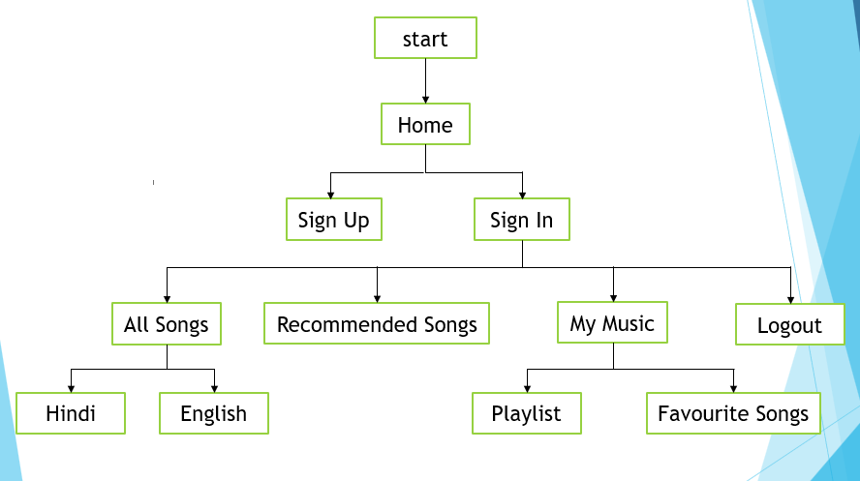
7. Flow Diagram
Notes:
11

Slide 12
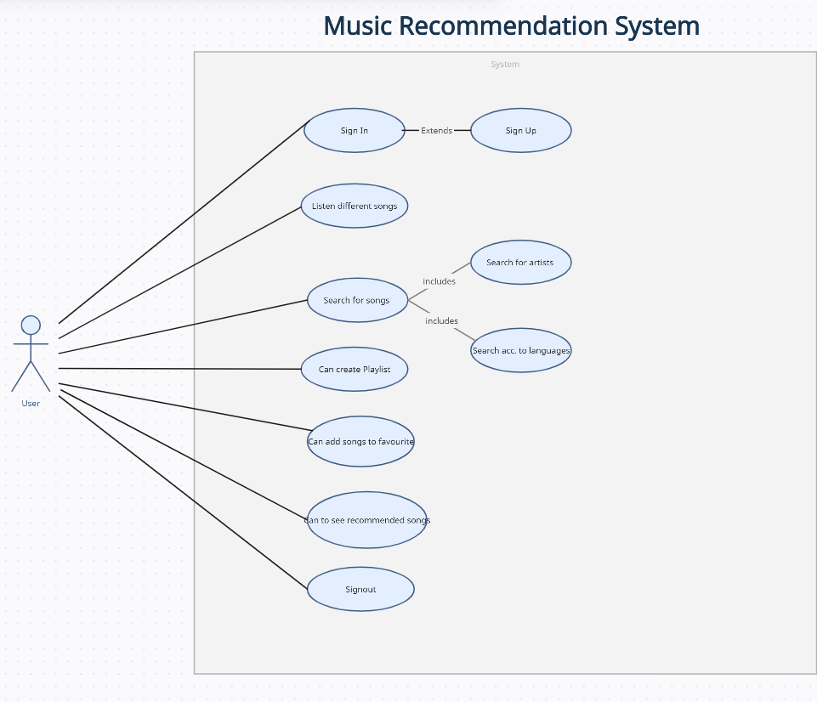
8. Use Case/Data Flow Diagram
Notes:
12

Slide 13
9. Technology Stack
Frontend : Python
Backend : SQLite
:
Notes:
13

Slide 14
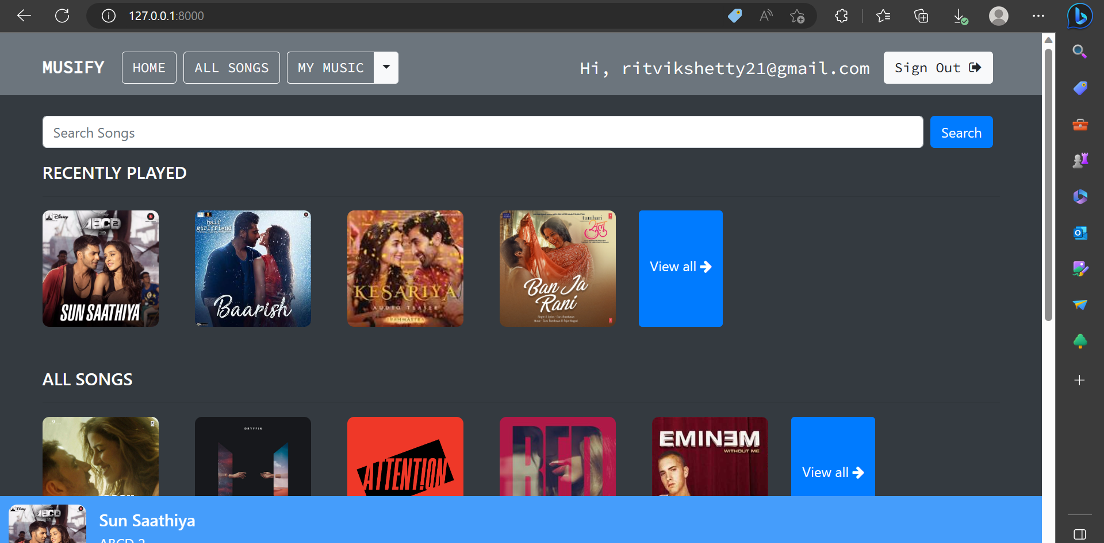
Suggestions in Review-1
Improve GUI

Slide 15
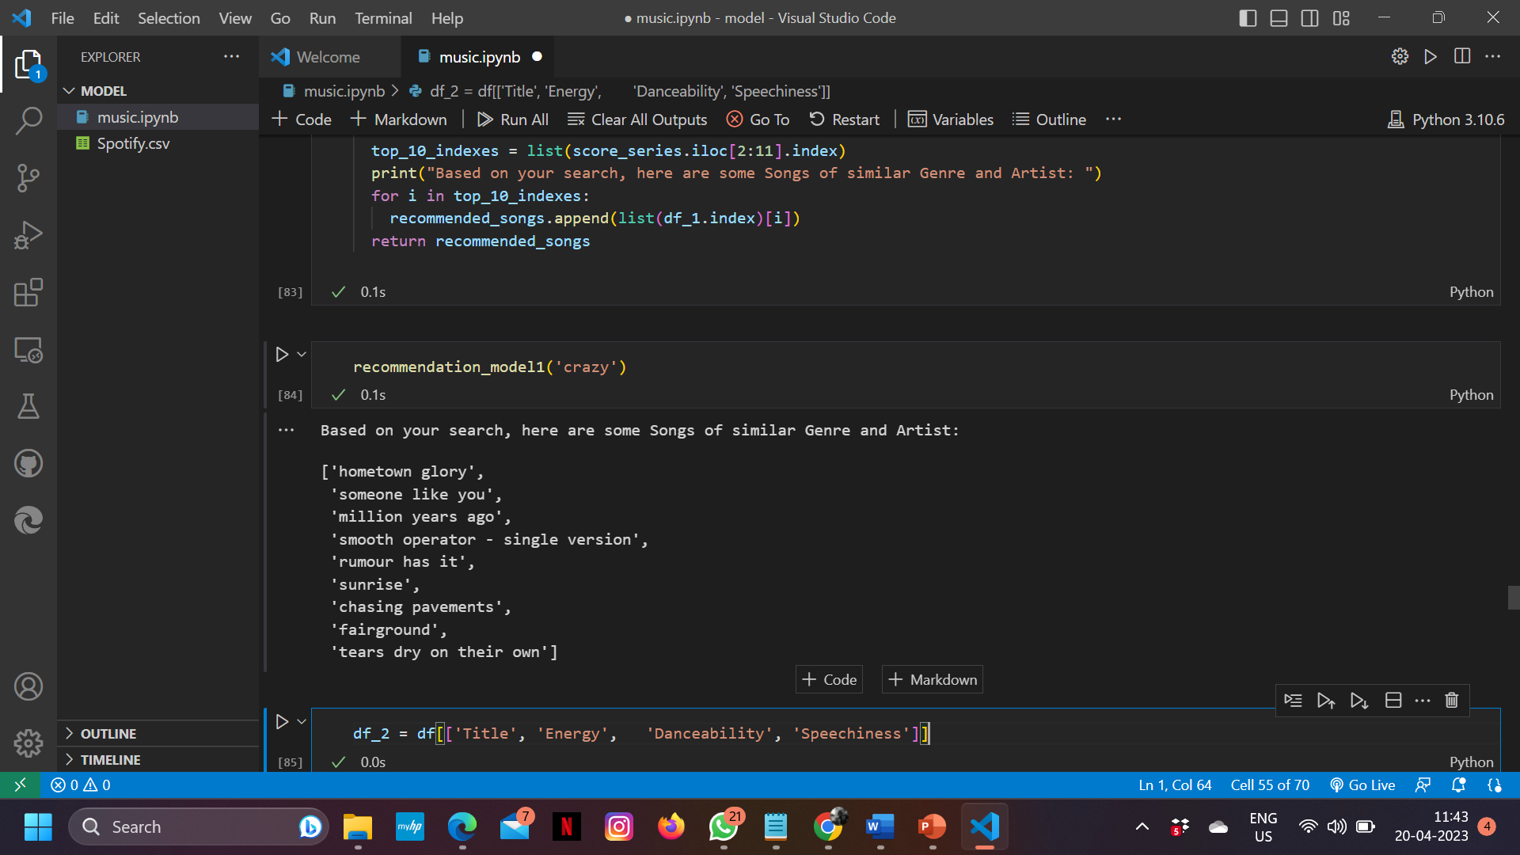
Model Training for Recommendation System :

Slide 16
Result and Discussion
Music recommendation system would depend on the specific algorithm and data inputs used to generate the recommendations. Generally, a music recommendation system would analyze user data such as listening history, user ratings and preferences, and demographic information to suggest songs, artists, or playlists that the user is likely to enjoy.
The recommendations could be based on a variety of factors, such as genre, tempo, artist similarity, popularity, and other user behavior patterns. The system might also incorporate machine learning algorithms to improve the accuracy of its recommendations over time, as it gathers more data on user preferences and behavior

Slide 17
Conclusion and Future Scope
In conclusion, music recommendation systems have become an essential tool for music streaming services and other digital music platforms. These systems use a variety of algorithms and data inputs to analyze user preferences and behavior patterns and suggest songs, artists, and playlists that users are likely to enjoy.

Slide 18
References
https://towardsdatascience.com/part-iii-building-a-song-recommendation-system-with-spotify-cf76b52705e7
https://www.enjoyalgorithms.com/blog/music-recommendation-system-using-ml

Slide 19
Thank You...!!
Notes:
19

